Slide 1
Viewing and clipping

Slide 2
outlines

Slide 3
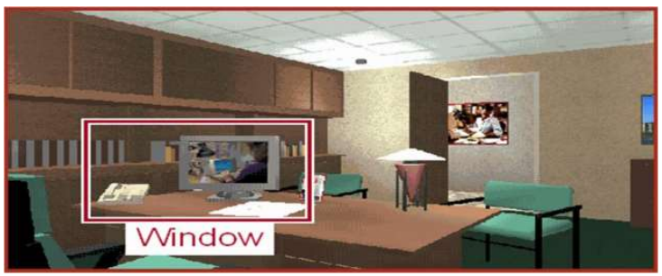
Window port and Viewport in Computer Graphics
Capturing images from the real world and displaying them on the screen is an astonishing process, only if we do not know the underlying process. Here, we will be studying how the images are captured. This process is held by the Window port and Viewport in Computer Graphics.
Window Port
The window port can be confused with the computer window but it isn’t the same. The window port is the area chosen from the real world for display. This window port decides what portion of the real world should be captured and be displayed on the screen.
So, the Window defines what is to be viewed. The widow port can thus be defined as,
➢ "A world-coordinate area selected for display is called a window. A window defines a rectangular area in the world coordinates."
➢ “The Capability to show some part of an object in a window is known as windowing.”
➢ “The rectangular area describes in the world coordinate system is called the window.”

Slide 4
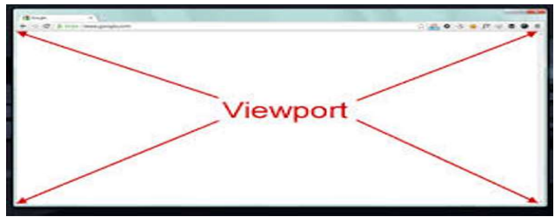
Viewport
Now, the Viewport is the area on a display device to which a window is mapped. “The viewport can be defined as an area on the screen which is used to display the object”. So, Viewport defines where is to be viewed. Thus, the viewport is nothing else but our device’s screen. The viewport can thus be defined as follows:
"A viewport is a polygon viewing region in computer graphics. The viewport is an area expressed in rendering-device-specific coordinates, e.g. pixels for screen coordinates, in which the objects of interest are going to be rendered."
So, to display the image on the computer screen, we must map our window port to the viewport. The capture ratio of the window might not always be similar to or easily adjustable to the viewport. Thus, some necessary transformations adjustments like clipping and cropping are performed on the window.

Slide 5
